Slide 1
CUSTOMER DATA
ANALYSIS
Shopping Behavior, Revenue & Demographics
BY
TEAM ID:PTID-CDA-MAR-26-11149
Bharanidharan J
Vishnu T
KarthickRaja S

Slide 2
ABOUT DATASET
This dataset contains shopping information from 10 different shopping malls between 2021 and 2023
We have gathered data from various age groups and genders to provide a comprehensive view of shopping habits in Istanbul
The dataset includes essential information such as invoice numbers, customer IDs, age, gender, payment methods, product categories, quantity, price, order dates, and shopping mall locations.

Slide 3
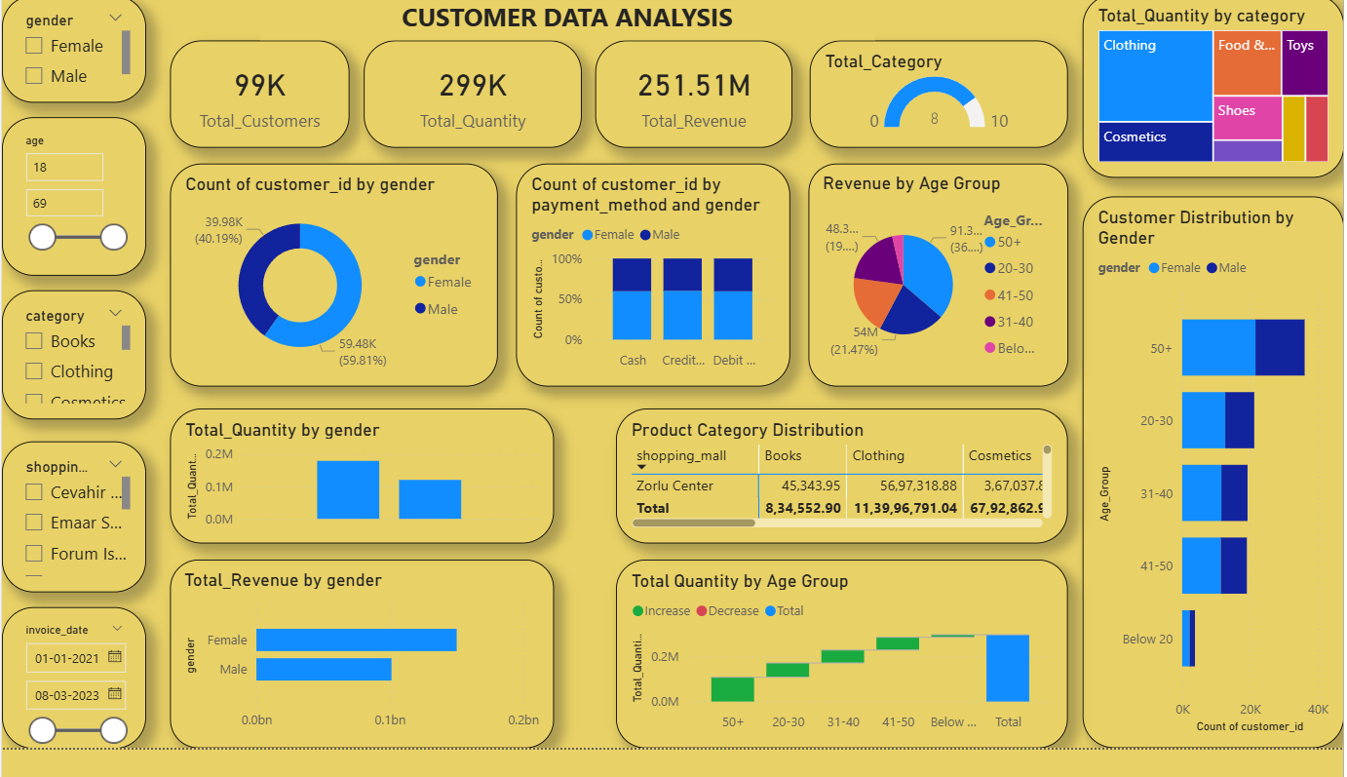
DASHBOARD
Content goes here

Slide 4
KEY PERFORMANCE INDICATORS
👥
📦
💰
🏷️
99K
299K
251.51M
5
Total Customers
Total Quantity Sold
Total Revenue
Product Categories
Business Snapshot
99K unique customers visited multiple Istanbul malls over the two-year period
Revenue of $251.51M was generated from 299K units sold across 5 product categories
Cash, Credit Card, and Debit Card are the three primary payment methods in use
Female customers make up roughly 60% of the total customer base
At a glance, these four numbers tell the full story: nearly 100,000 people shopped here, spending a quarter-billion dollars on 300,000 items across five categories. The business is healthy and diverse — driven largely by female shoppers, which is a key insight that should shape marketing and product strategy going forward.

Slide 5
GENDER & PAYMENT METHOD ANALYSIS
Customer Distribution by Gender
Payment Method by Gender
Female
59.81% ~59.5K
Male
40.19% ~39.9K
Women outnumber male shoppers nearly 3:2, making them the core customer segment. On payment preferences, both genders behave almost identically — Credit Card edges slightly ahead, but Cash and Debit are equally popular. Ensuring all payment options remain seamless and readily available is essential to keeping every customer happy.

Slide 6
REVENUE BY AGE GROUP
Total Revenue ($M) by Age Group
The 50+ age group is the biggest spender by far — contributing $91.3M, more than double any other group. This tells us older shoppers have stronger purchasing power and higher loyalty. Meanwhile, the 20-30 and Below 20 segments represent a growing future market — targeted digital promotions could unlock significant untapped potential here.

Slide 7
PRODUCT CATEGORY PERFORMANCE
Revenue by Product Category (All Malls)
Clothing
Shoes
Books
Cosmetics
Toys
Top Seller
2nd Rank
3rd Rank
4th Rank
5th Rank
Clothing dominates sales by a massive margin — earning more than double the second-place Shoes category. Fashion is clearly the primary shopping motivation for visitors. Food & Beverages ranks last, but it's vital for foot traffic and dwell time. Investing in Clothing variety and creating attractive food experiences can significantly boost total mall revenue.

Slide 8
SHOPPING MALL PERFORMANCE
Total Revenue by Shopping Mall
All six malls perform remarkably close to each other — the gap between first and last is less than 1% of total revenue. This shows that shoppers are evenly distributed across the city and no single mall has a monopoly. Metrocol AVM holds a slight lead. For operators, this balance signals that the next growth lever is customer experience and brand differentiation, not just location.

Slide 9
GENDER-BASED REVENUE & QUANTITY COMPARISON
Total Revenue by Gender
Total Quantity by Gender
Female shoppers don't just visit more — they also spend significantly more. With $152M in revenue and 179K units purchased, women outspend men by over 50% in both value and volume. This strongly suggests that female-centric product lines, loyalty rewards, and targeted campaigns will deliver the highest return on every marketing dollar invested.

Slide 10
SUGGESTIONS
Enhance Customer Engagement
Female customers contribute more to sales
Introduce women-focused campaigns and personalized offers
Implement loyalty programs to retain frequent buyers
2. Increase Revenue from Top Categories
Clothing and Cosmetics generate the highest revenue
Focus on:
Discounts and combo offers
Cross-selling strategies
Promote low-performing categories with targeted campaigns

Slide 11
SUGGESTIONS
3. Optimize Payment Strategies
Credit and Debit cards are widely used Offer for:
Cashback and rewards EMI/payment flexibility
Introduce modern methods like UPI and Buy Now Pay Later (BNPL)
4. Improve Store/Mall Performance
Identify top-performing shopping malls and replicate strategies
For low-performing locations:
Use localized promotions
Adjust product assortment
Implement location-based marketing

Slide 12
SUGGESTIONS
5. Target High-Value Age Group
Customers aged 20–40 are the most active
Focus marketing efforts on this segment through:
Digital advertising
Trend-based product offerings
Use personalized recommendations
“These strategies will help improve revenue, customer engagement and overall business performance.”

Slide 13
KEY INSIGHTS &
CONCLUSIONS
👩 Female customers dominate at ~60%, driving both revenue and quantity purchased
👴 Age group 50+ is the top revenue driver at $91.3M — loyalty programs for this group are a must
👗 Clothing is the runaway #1 category — fashion is clearly the primary reason people visit these malls
🏬 Revenue is evenly spread across all malls — differentiation through experience is the next growth lever
💳 All three payment methods are used equally — keep all channels smooth and friction-free

Slide 14
Thank You!

